Slide 1
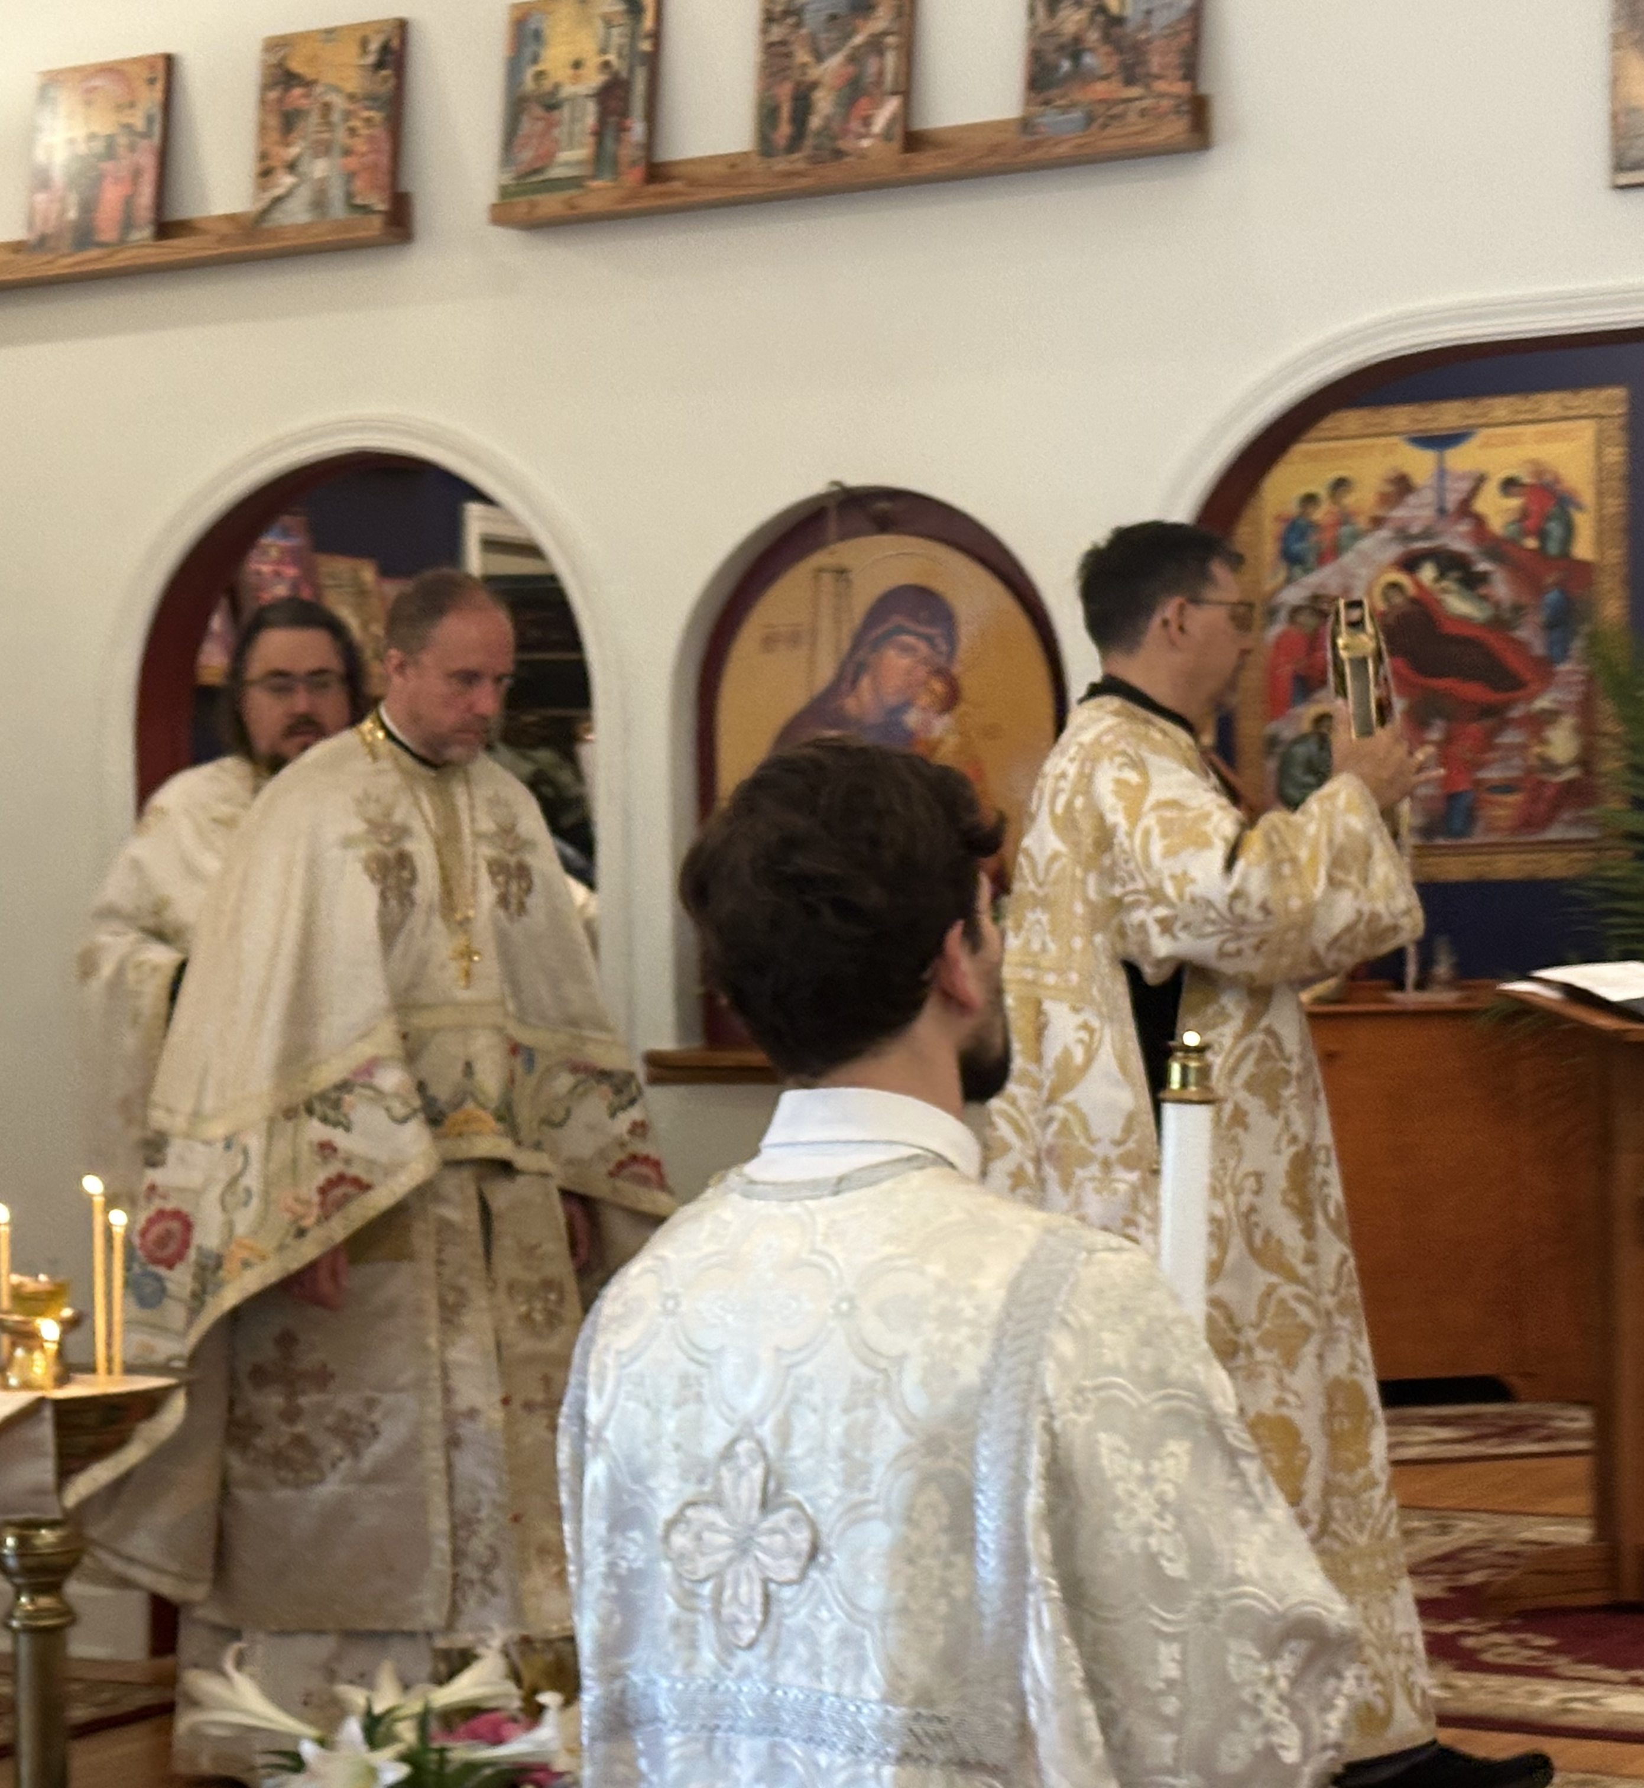
UNDERSTANDING THE DIVINE LITURGY
The Antiphons:
The historical origins of the Antiphons
The three Antiphons and their meaning
The theology of “Only-begotten Son”
Preparing to encounter Christ in the Gospel

Slide 2
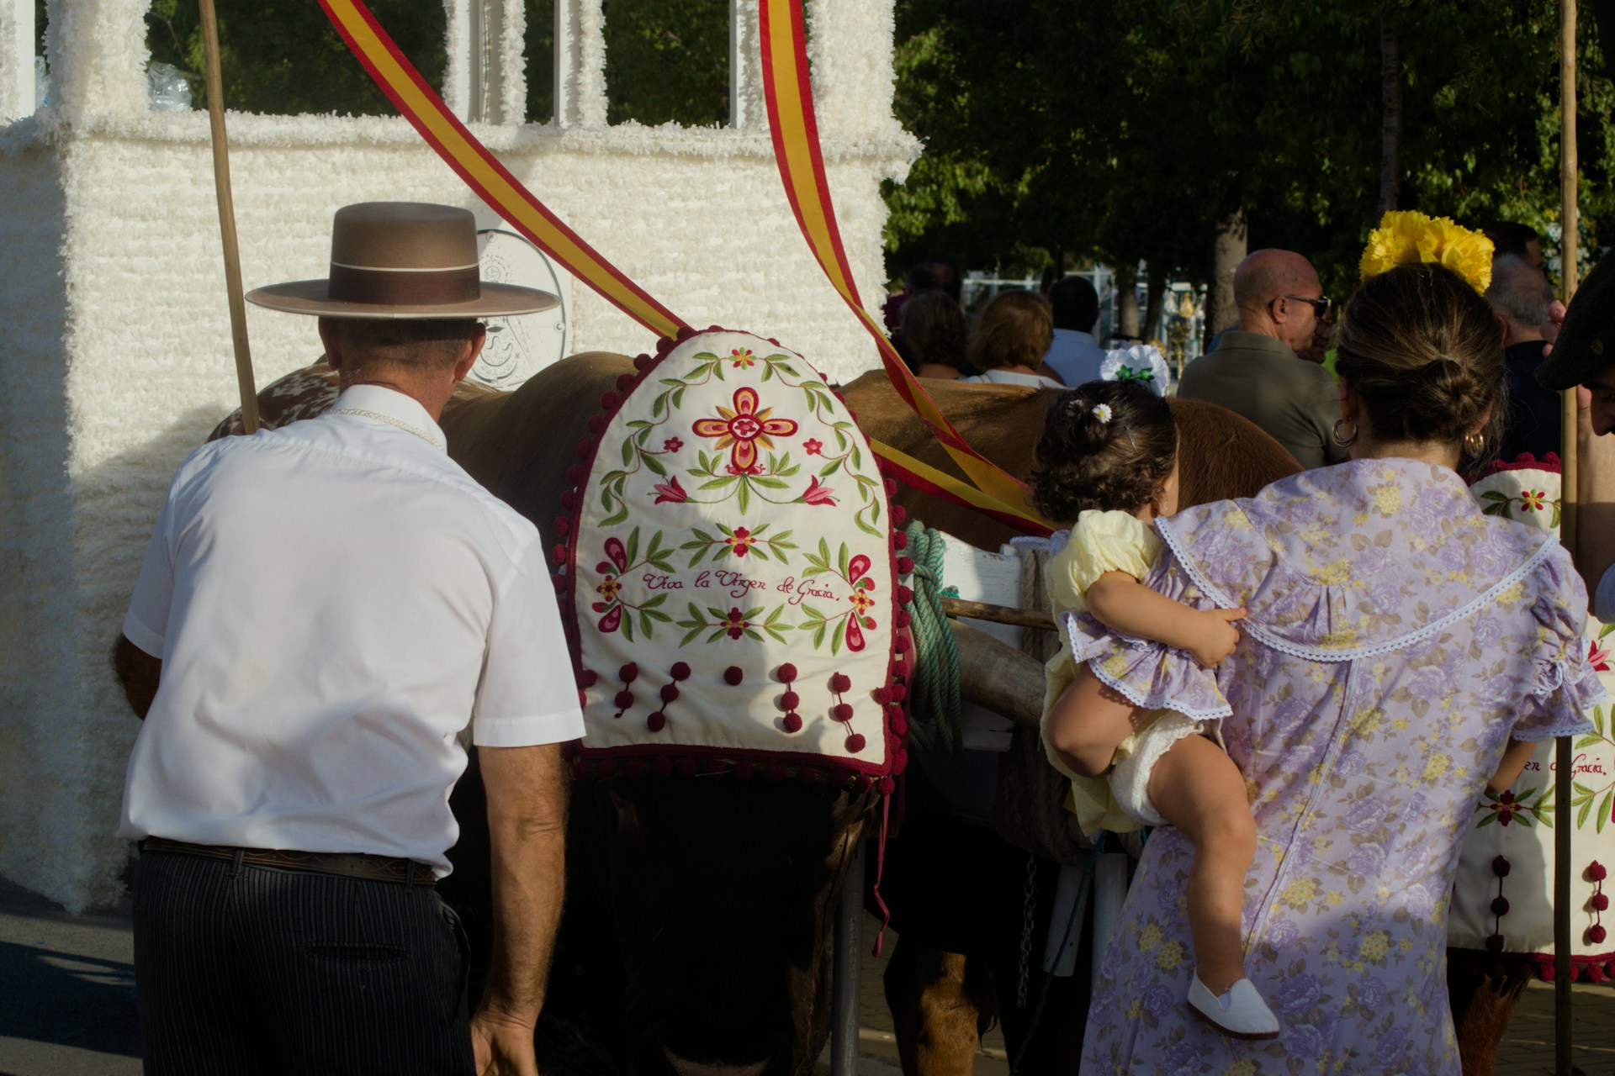
A QUESTION TO BEGIN
Why Do We Sing the Antiphons at the Beginning of the Divine Liturgy?
To understand why we sing the Antiphons, we first need to understand how Christians gathered for worship in the ancient Church.

Slide 3
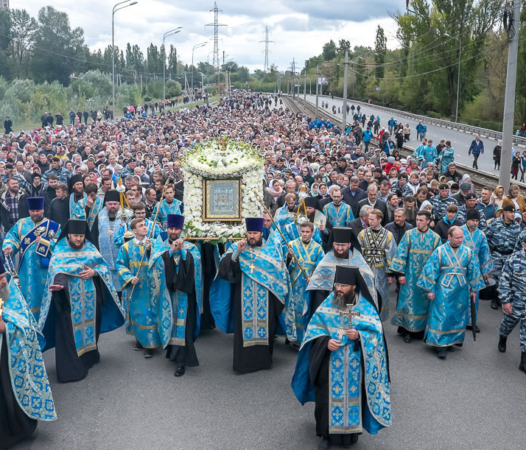
From the Streets to the Sanctuary
Early Christian worship included public processions.
In Constantinople, Christians gathered at designated locations throughout the city.
Psalms and hymns accompanied their processions toward the church.
These processions brought the Christian community together in prayer.
The journey itself became an expression of the Church’s worship.

Slide 4
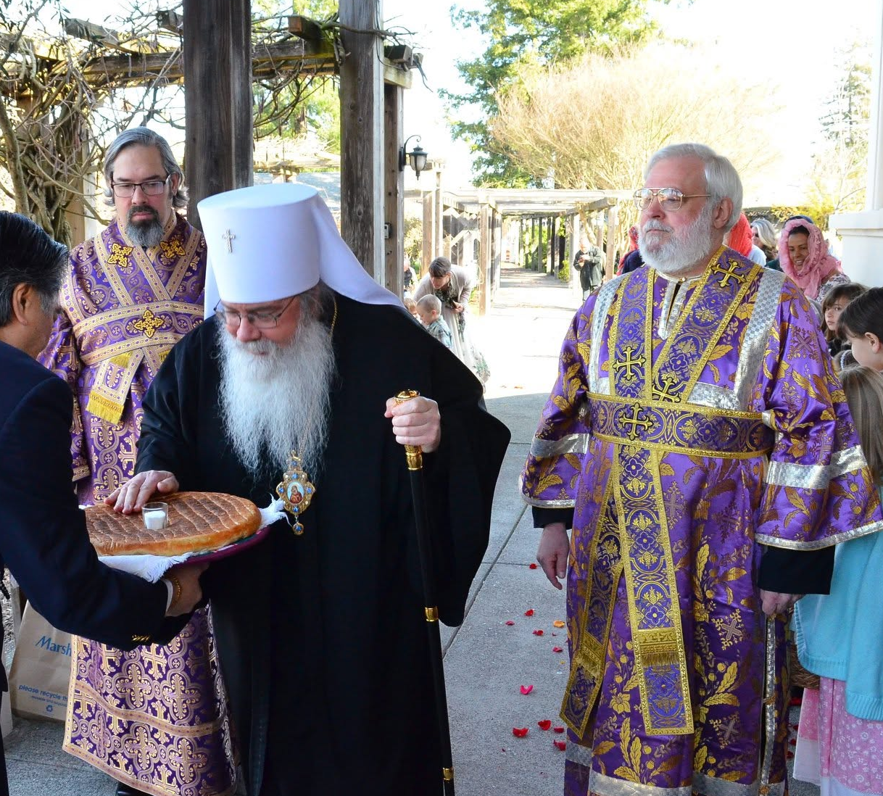
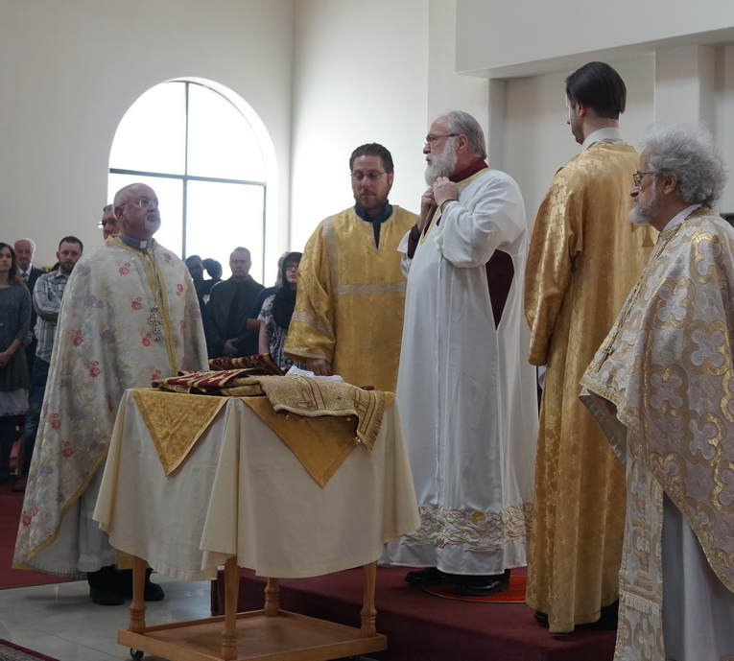
Here’s Johnny!!! The Bishop’s Arrival

Slide 5
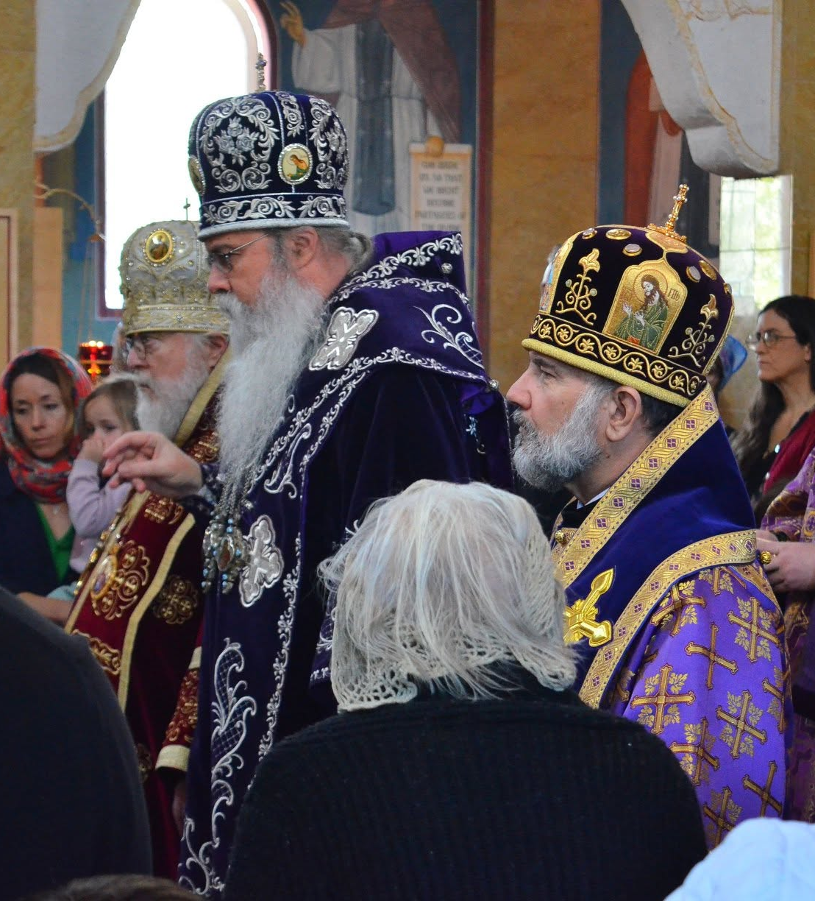
The Liturgy Really Begins??
The bishop’s arrival marked the gathering of the Church.
Clergy and faithful welcomed their shepherd.
The entrance was originally a procession into the church.
The bishop represented the unity of the local Church.
This tradition helped shape the Little Entrance.
Traces remain in today’s hierarchical Liturgies.

Slide 6
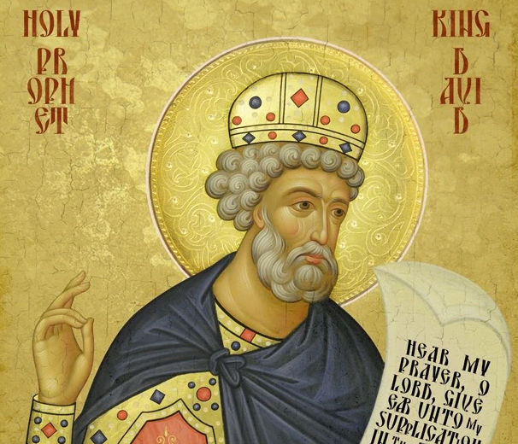
The First Antiphon: Bless the Lord, O My Soul
Psalm 102 (103):
“Bless the Lord, O my soul! Blessed art Thou, O Lord!”
Remembering God’s mercy, forgiveness, and compassion
Thanksgiving as the foundation of worship
The intercessions of the Theotokos
The First Prayer of the Antiphons and the Little Litany

Slide 7
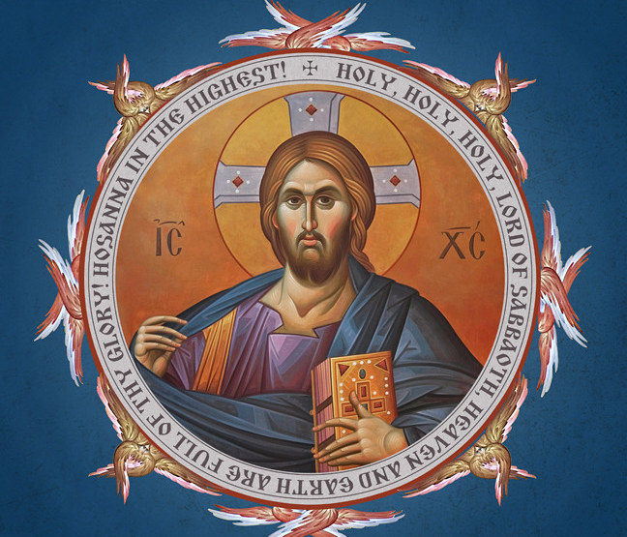
The Second Antiphon: Praise the Lord, O My Soul
Psalm 145 (146): “Praise the Lord, O my soul!”
“Put not your trust in princes, in sons of men.”
Earthly rulers and human accomplishments are temporary.
God’s Kingdom and faithfulness endure forever.
The second Little Litany and the priest’s prayer.

Slide 8
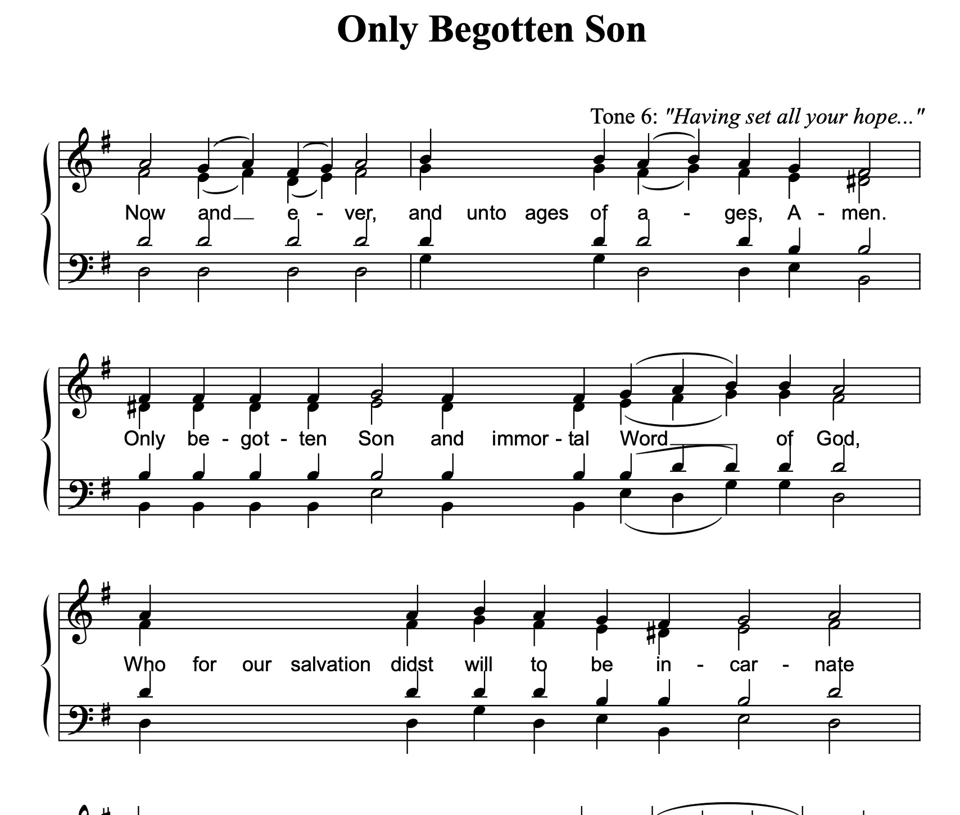
Only-begotten Son: The Faith of the Church
A Creed Before the Creed - "Justinian's Hymn", the "Anthem of Orthodoxy" and/or the "Hymn of the Incarnation”
Only-begotten Son and immortal Word of God, Who for our salvation didst will to be incarnate of the holy Theotokos and Ever-Virgin Mary; Who without change didst become man and wast crucified, O Christ our God, trampling down death by death; Who art one of the Holy Trinity, glorified with the Father and the Holy Spirit: save us!

Slide 9
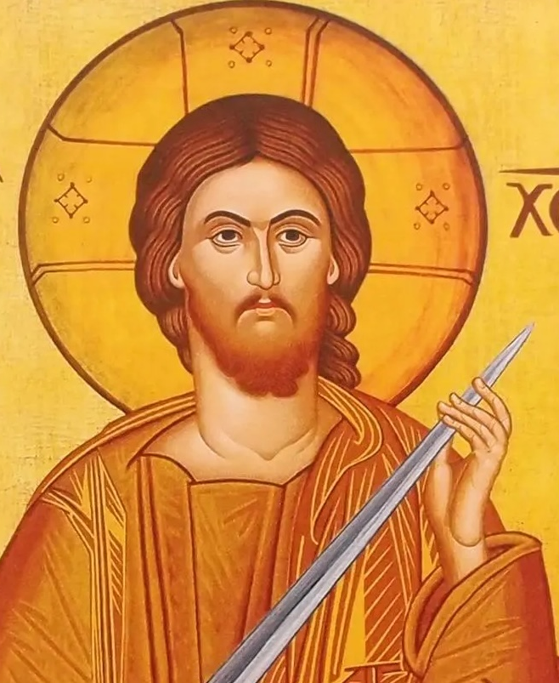
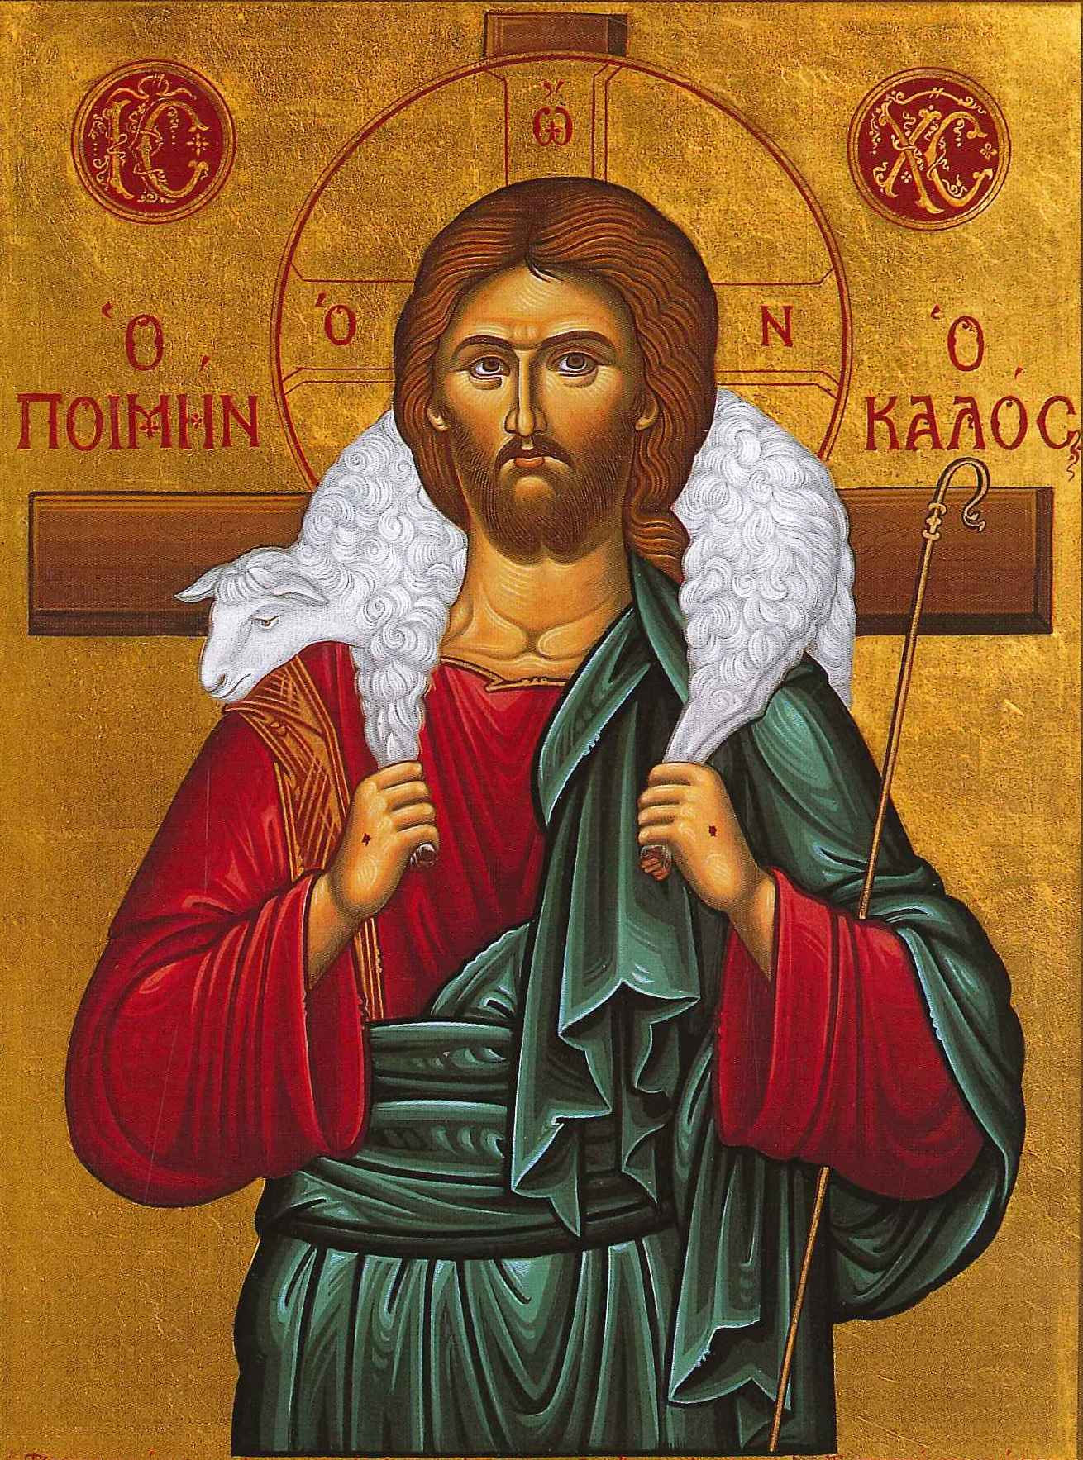
What Does “Only-begotten Son” Teach Us?
Who Christ Is
Eternal Son and Word of God
Fully God and fully man
What Christ Has Done
Became incarnate of the Theotokos
Was crucified and conquered death
What the Church Confesses
One Person in two natures
One of the Holy Trinity

Slide 10
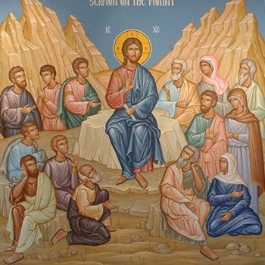
The Third Antiphon: The Beatitudes
Matthew 5:3–12: Christ’s Sermon on the Mount
“In Thy Kingdom remember us, O Lord.”
Blessed are the poor in spirit, the meek, and the merciful.
Blessed are the pure in heart and the peacemakers.
The Beatitudes reveal what it means to live as citizens of God’s Kingdom.

Slide 11
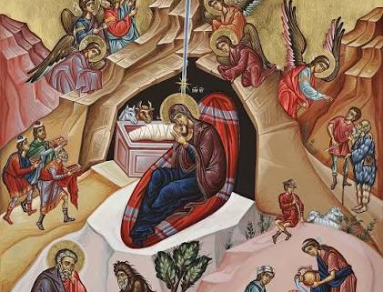
Why Do the Antiphons Change?
The Church’s Calendar Shapes Our Worship
The Antiphons are not identical at every Divine Liturgy.
Typical Antiphons are commonly used on ordinary Sundays.
Major feasts may have their own appointed Antiphons.
Festal Antiphons use Scripture to proclaim the meaning of the celebration.
The Beatitudes are not appointed for every occasion.

Slide 12
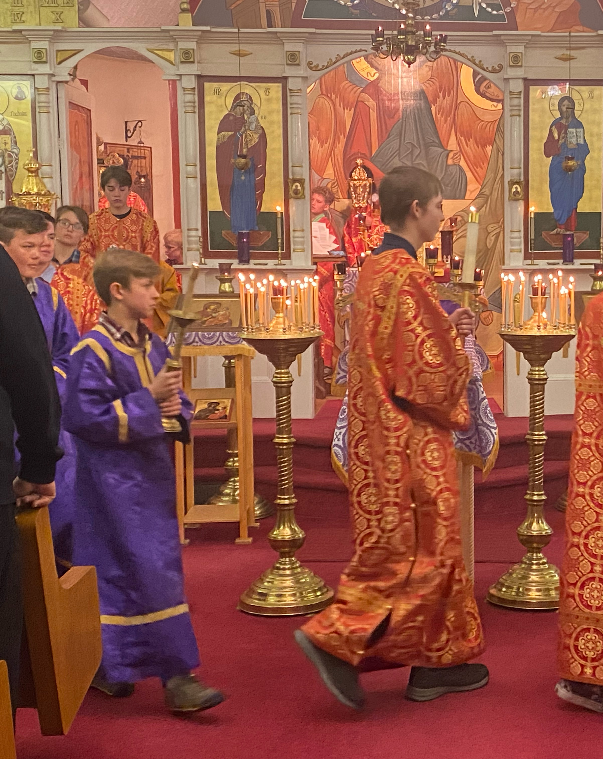
From the Antiphons to the Little Entrance
1. Thanksgiving
The First Antiphon reminds us of God’s mercy and goodness.
↓
2. Confession of Faith
The Second Antiphon proclaims Christ’s Incarnation and saving work.
↓
3. Life in the Kingdom
The Third Antiphon teaches us how Christ calls us to live.
↓
The Little Entrance
The Holy Gospel is carried into the midst of the faithful.
DIVINE LITURGY • CLASS 2

Slide 13
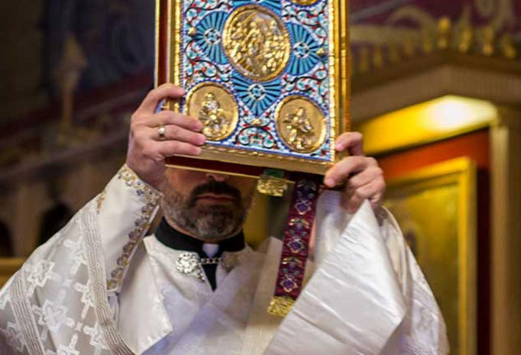
NEXT CLASS
The Little Entrance: Christ Comes Among His People

