Slide 1
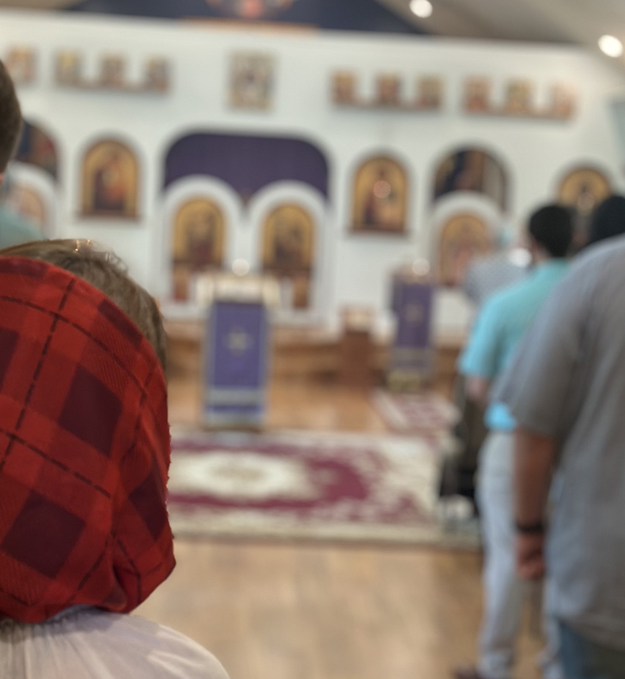
UNDERSTANDING THE DIVINE LITURGY
Why Do We Pray
and Worship?
“When you see the Lord immolated and lying upon the altar… can you think that you are still among men and on earth? Or are you not lifted up to heaven?” - St. John Chrysostom
“The oblation of the Church… which the Lord gave instructions to be offered throughout all the world, is accounted with God a pure sacrifice.” - St. Irenaeus of Lyons
“I desire the bread of God, which is the flesh of Jesus Christ… and for drink I desire His blood, which is love incorruptible.” - St. Ignatius of Antioch
“O Existing One, Master and Lord; O God, the almighty and adorable Father: it is truly proper, right, and befitting the majesty of Your holiness to praise You, to hymn You, to bless You, to worship You, to give thanks to You, to glorify You, the only God Who truly exists, and to offer You this our rational worship with a contrite heart and in a spirit of humility, for You have granted us the knowledge of Your truth. Who can relate Your mighty acts? Or make all Your praises known? Who can tell of all Your miracles at all times? O Master of all, Lord of heaven and earth, and of all creation both visible and invisible, You sit upon the throne of glory and behold the depths…” - St. Basil Liturgy Anaphora Prayer
1

Slide 2
A QUESTION TO BEGIN
If God needs nothing,
why does He want us to worship Him?
Acts 17:24–25
2

Slide 3
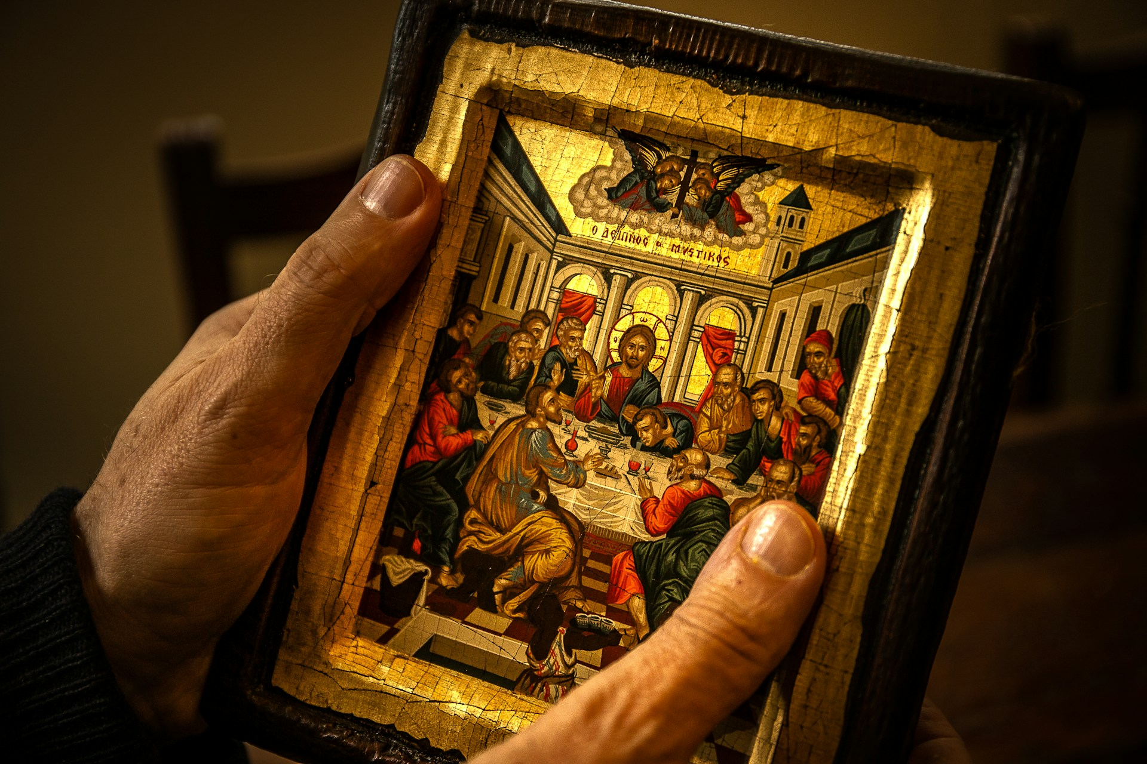
DIVINE LITURGY • CLASS 1
What Is Prayer?
Prayer is communion with God.
Praise • Thanksgiving • Repentance • Intercession • Petition
God already knows what we need.
Prayer is not informing God. It is turning ourselves toward Him.
“Do not be like them, for your Father knows what you need before you ask him.” Matthew 6:8
3

Slide 4
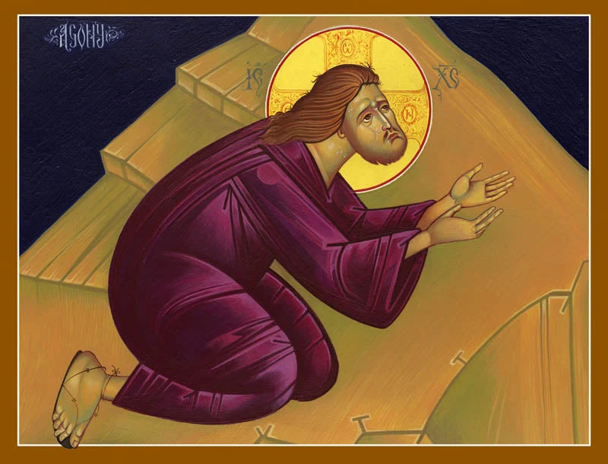
DIVINE LITURGY • CLASS 1
Christ Himself Prayed
Christ withdraws to pray. • Luke 5:16
Christ teaches His disciples to pray. • Matthew 6:9–13
Christ prays before His Passion. • John 17
Prayer is about communion, not merely asking for things.
4

Slide 5
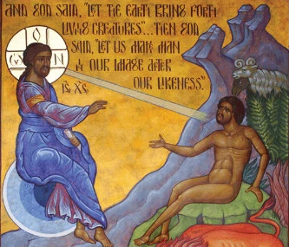
DIVINE LITURGY • CLASS 1
Created for Communion
Human beings are created in the image and likeness of God.
We were created to know God and participate in His life.
The Christian life is not simply learning facts about God.
It is entering into communion with Him.
“Then God said, “Let us make man in our image, after our likeness; and let them have dominion over the fish of the sea, and over the birds of the air, and over the cattle, and over all the earth, and over every creeping thing that creeps upon the earth.” So God created man in his own image, in the image of God he created him; male and female he created them.” Genesis 1:26–27
5

Slide 6
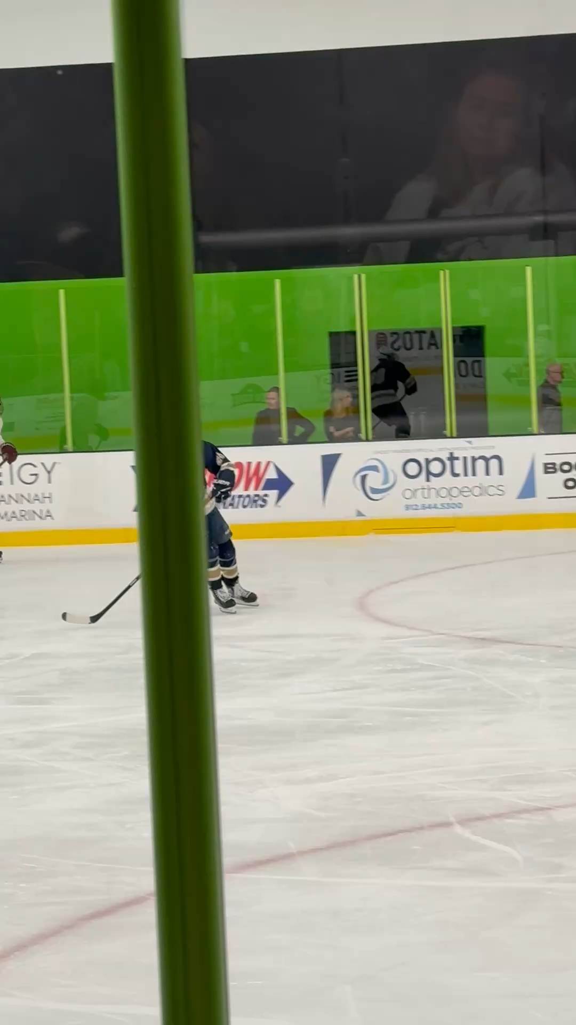
DIVINE LITURGY • CLASS 1
Knowing About God vs. Knowing God
#PutEvanIn
6

Slide 7
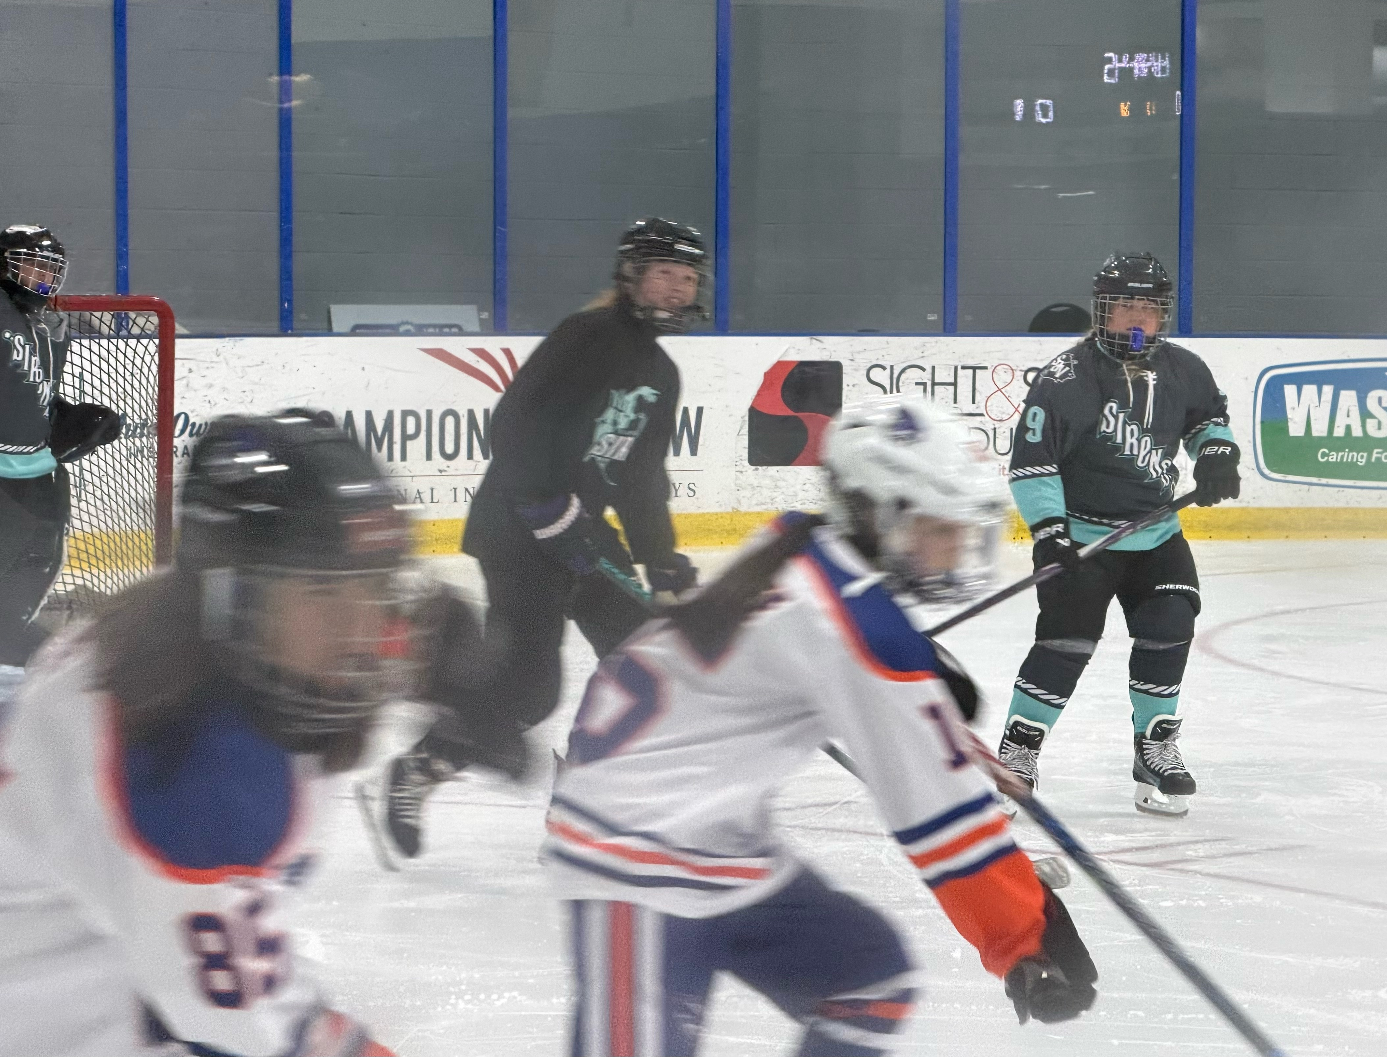
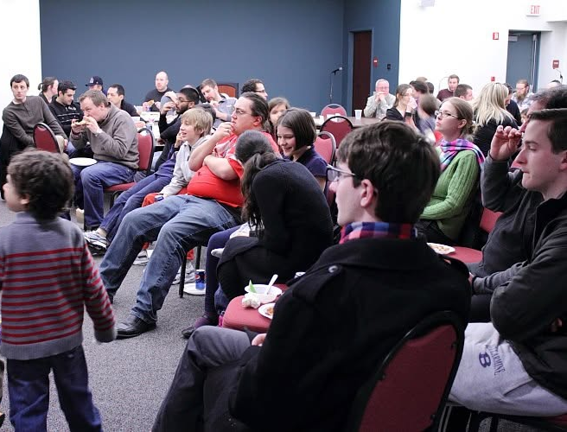
DIVINE LITURGY • CLASS 1
Knowing About God vs. Knowing God
PLAYING
WATCHING / READING
You can know every rule, statistic, and strategy without ever stepping onto the field.
6

Slide 8
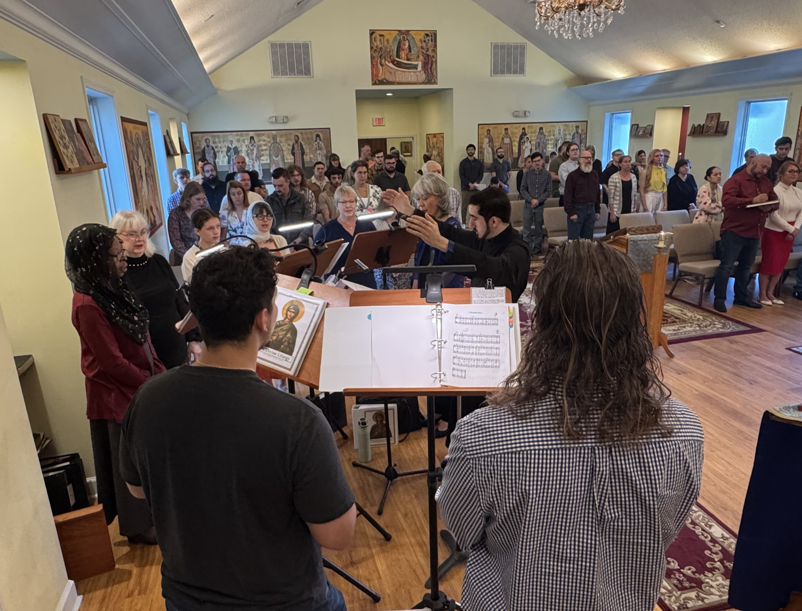
DIVINE LITURGY • CLASS 1
Worship Requires Active Presence
You do not learn to play a sport by remaining in the stands.
You can read about the Liturgy without actually entering into its prayer.
Orthodox worship asks us to be present, attentive, responsive, and involved.
We do not merely observe worship. We participate in it.
The goal is not spectatorship. It is communion.
7

Slide 9
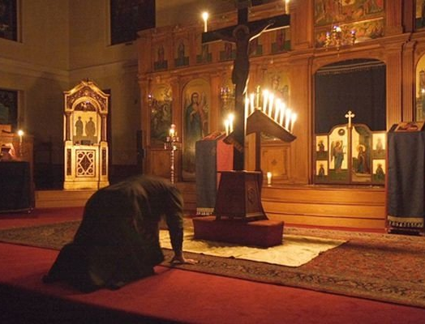
DIVINE LITURGY • CLASS 1
What Is Worship?
Worship is offering.
“Present your bodies a living sacrifice...” • Romans 12:1
We bring our minds, bodies, voices, attention, repentance, and thanksgiving.
Worship is something we do, not merely something we watch.
8

Slide 10
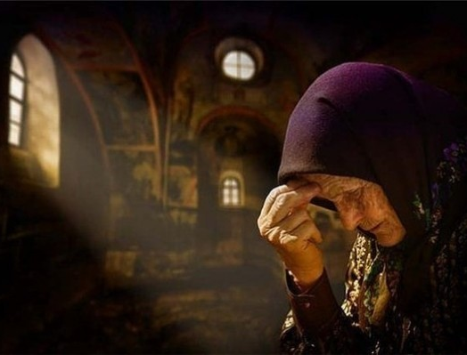
DIVINE LITURGY • CLASS 1
The Whole Person Worships
We stand.
We bow and make the sign of the Cross.
We sing and respond.
We venerate.
We receive the Holy Gifts.
Christian worship is embodied because the Word became flesh.
9

Slide 11
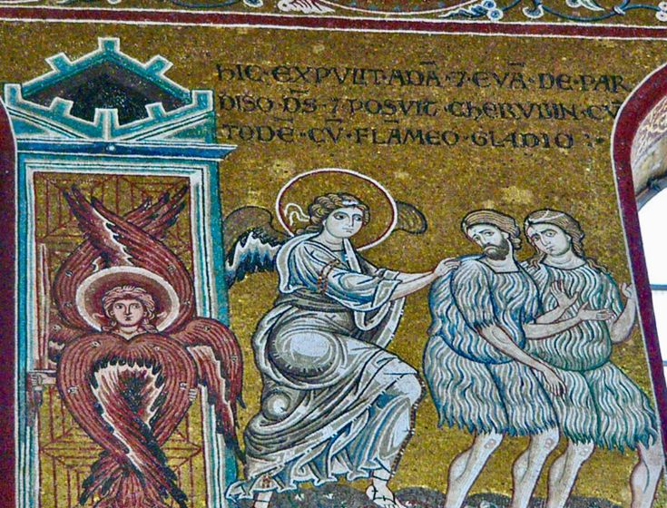
DIVINE LITURGY • CLASS 1
Sin Pulls Us Away
After sin, Adam hides from God.
Sin makes us withdraw, distract ourselves, and turn inward.
Prayer and worship call us out of hiding.
They train us to stand attentively before God.
“And they heard the sound of the Lord God walking in the garden in the cool of the day, and the man and his wife hid themselves from the presence of the Lord God among the trees of the garden.” Genesis 3:8
10

Slide 12
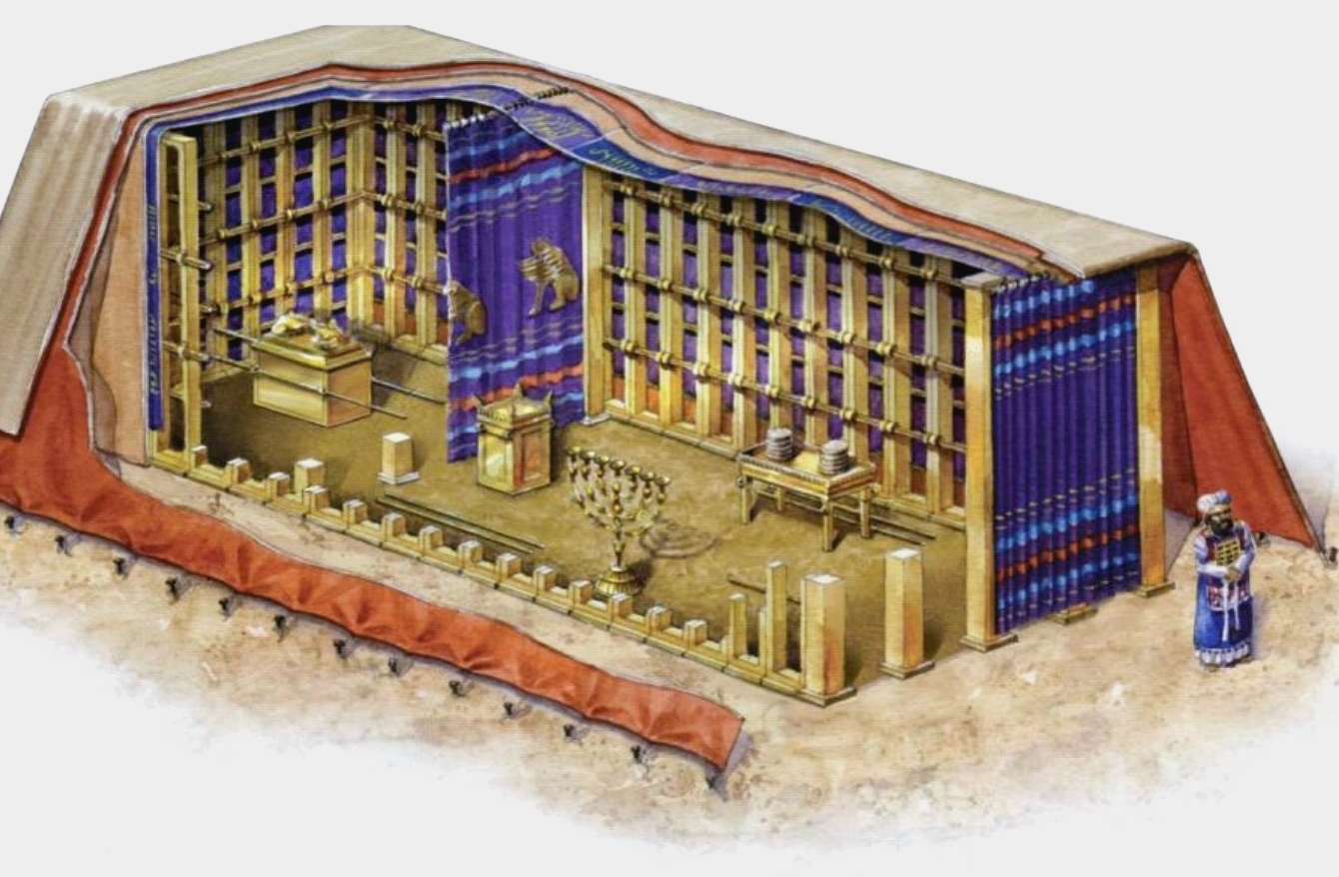
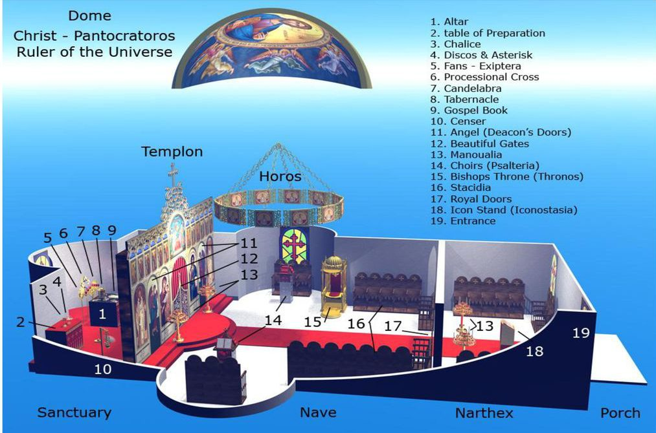
DIVINE LITURGY • CLASS 1
Worship Has Always Involved Offering
Abel → Noah → Abraham
Passover → Tabernacle → Temple
Christ offers Himself.
“But will God indeed dwell on the earth? Behold, heaven and the highest heaven cannot contain thee; how much less this house which I have built!” 1 Kings 8:27
“The cup of blessing which we bless, is it not a participation in the blood of Christ? The bread which we break, is it not a participation in the body of Christ?” 1 Corinthians 10:16
THE OLD TEMPLE
THE NEW TEMPLE
11

Slide 13
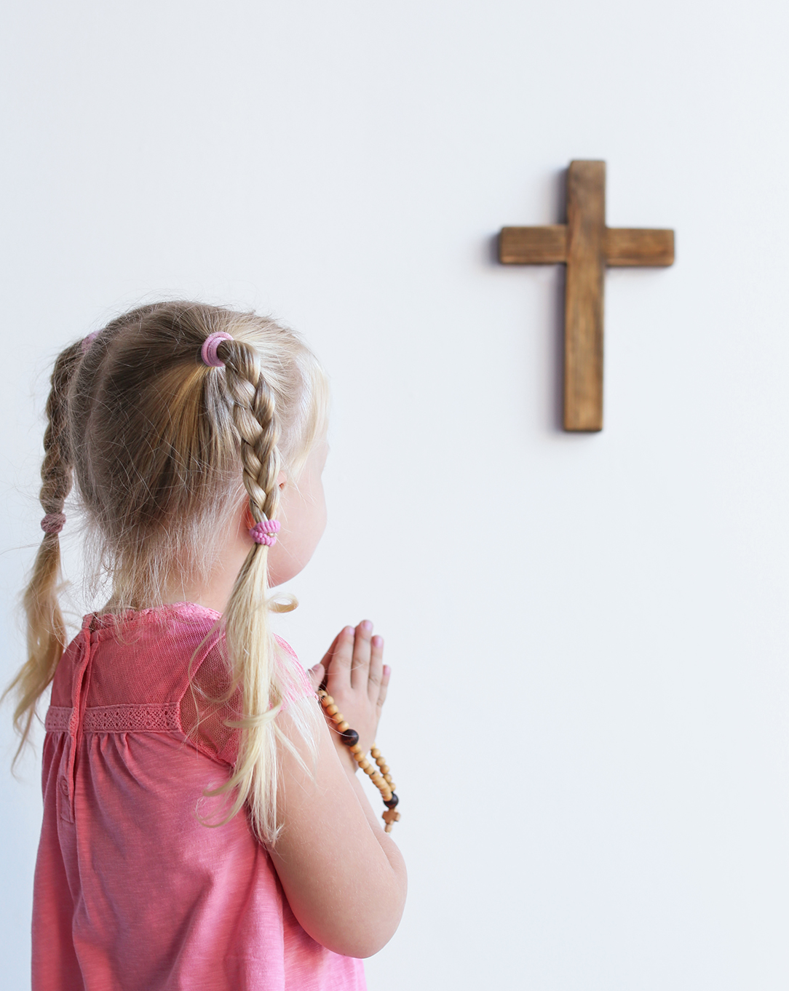
CAN’T I JUST
PRAY AT HOME?
You should pray at home, but Christianity and Orthodoxy is not a private religion.
“And they devoted themselves to the apostles’ teaching and fellowship, to the breaking of bread and the prayers.” Acts 2:42
Teaching • Fellowship • Breaking of Bread • Prayers
12

Slide 14
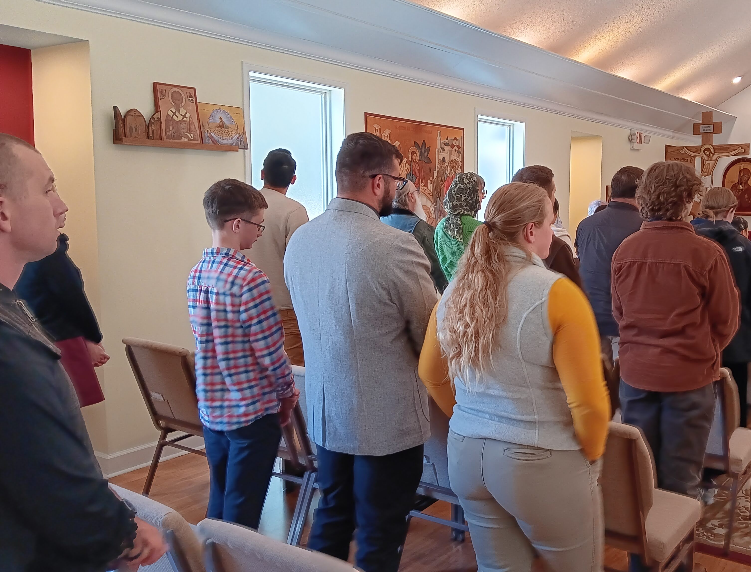
DIVINE LITURGY • CLASS 1
You Cannot Be the Church Alone
Christianity is personal, but never merely private.
We are members of the Body of Christ.
You cannot baptize yourself.
You cannot chrismate yourself.
You cannot give yourself the Eucharist.
“Now you are the body of Christ and individually members of it.” 1 Corinthians 12:27
13

Slide 15
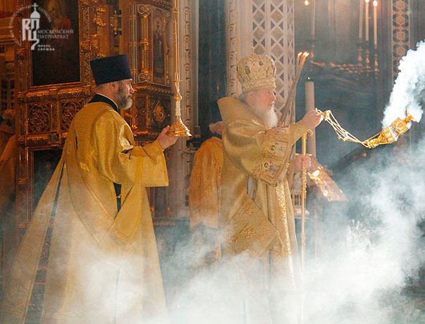
DIVINE LITURGY • CLASS 1
What Does Worship Look Like in Heaven?
Read Revelation 4–5.
Altar • Incense • Elders
White garments • Prostrations • Hymns
Angels • Saints • The Lamb
Does any of this look familiar?
“Holy, holy, holy, is the Lord God Almighty, who was and is and is to come!”
14

Slide 16
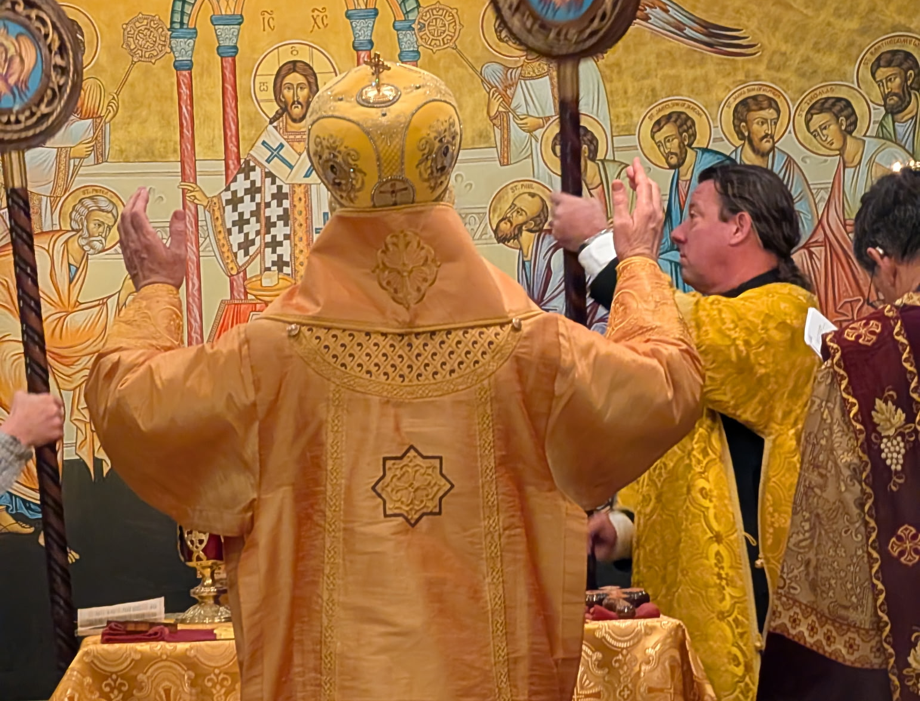
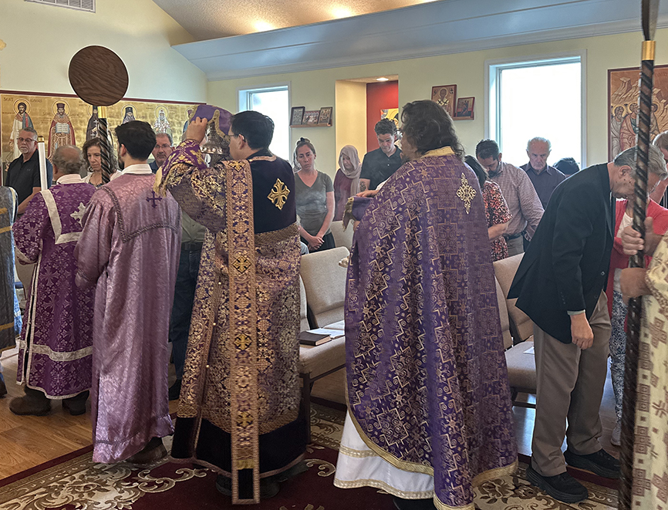
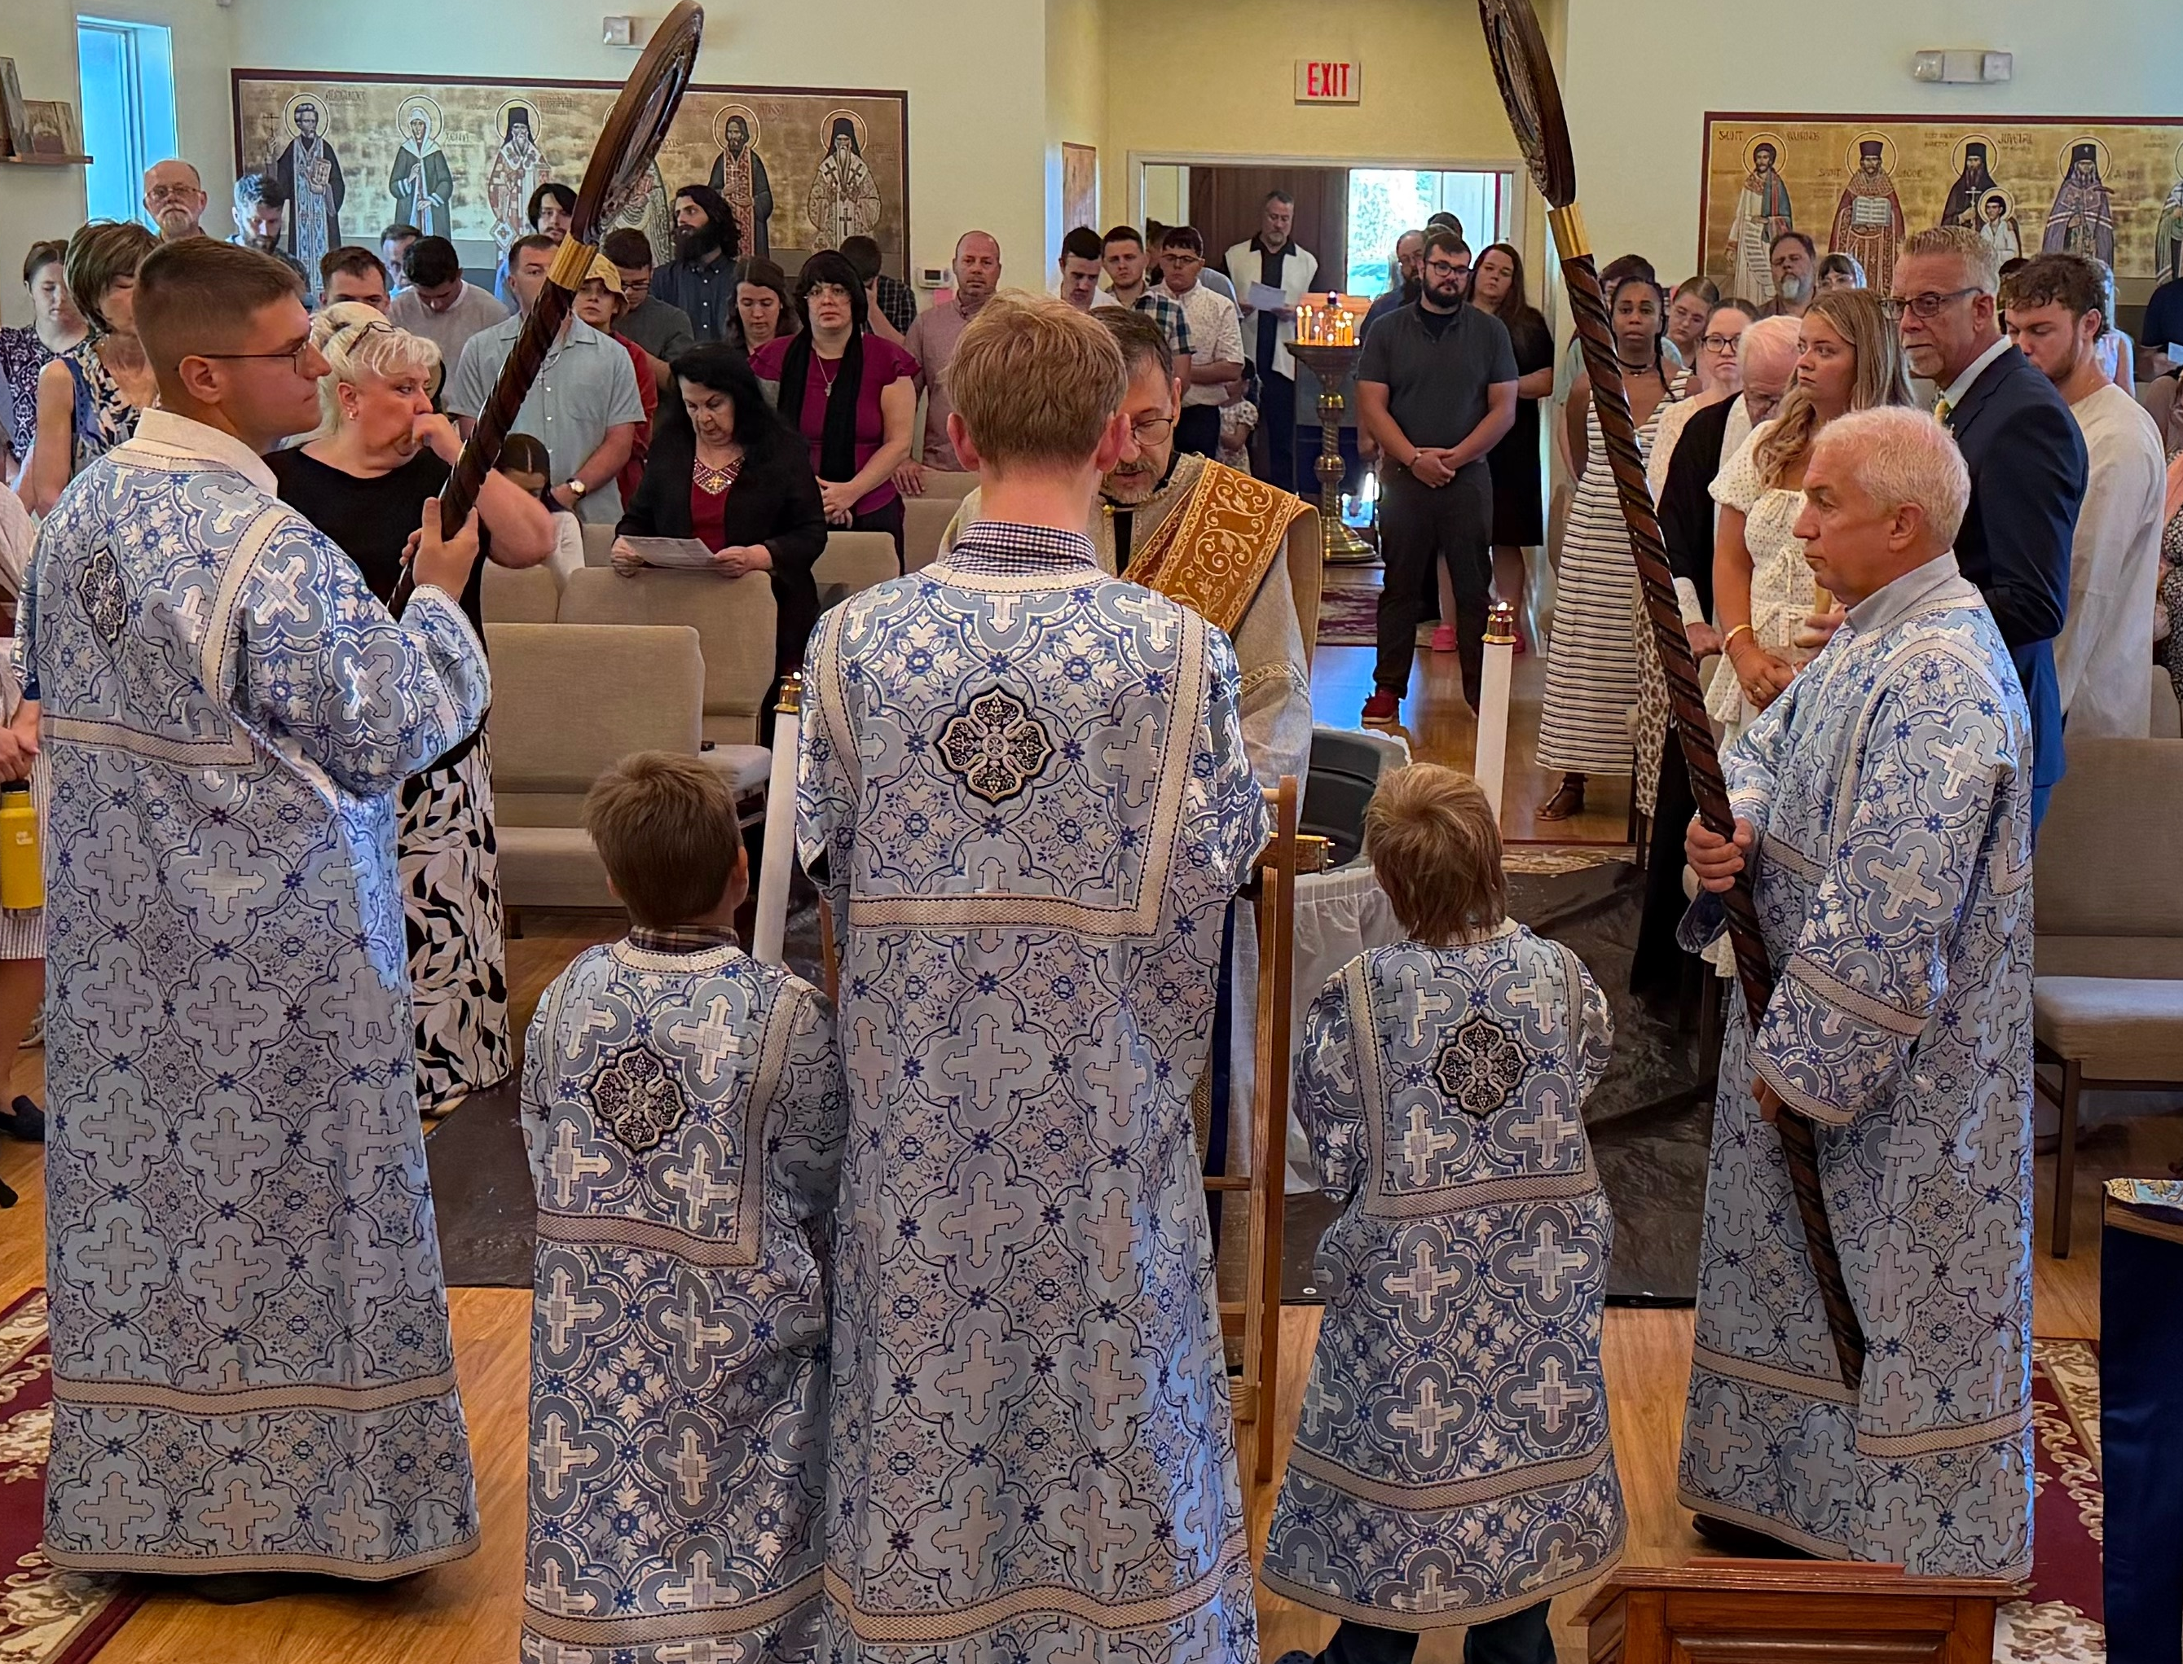
The Liturgy is not simply something we watch God do.
In Christ, we are brought into the worship already taking place before the throne of God.
15

Slide 17
DIVINE LITURGY • CLASS 1
Spectator or Participant?
SPECTATOR
PARTICIPANT
“Did I like it?”
“Was I entertained?”
“Was the sermon good?”
“What did I get out of it?”
“Did I pray?”
“Was I attentive?”
“Did I repent?”
“What did I offer to God?”
16

Slide 18
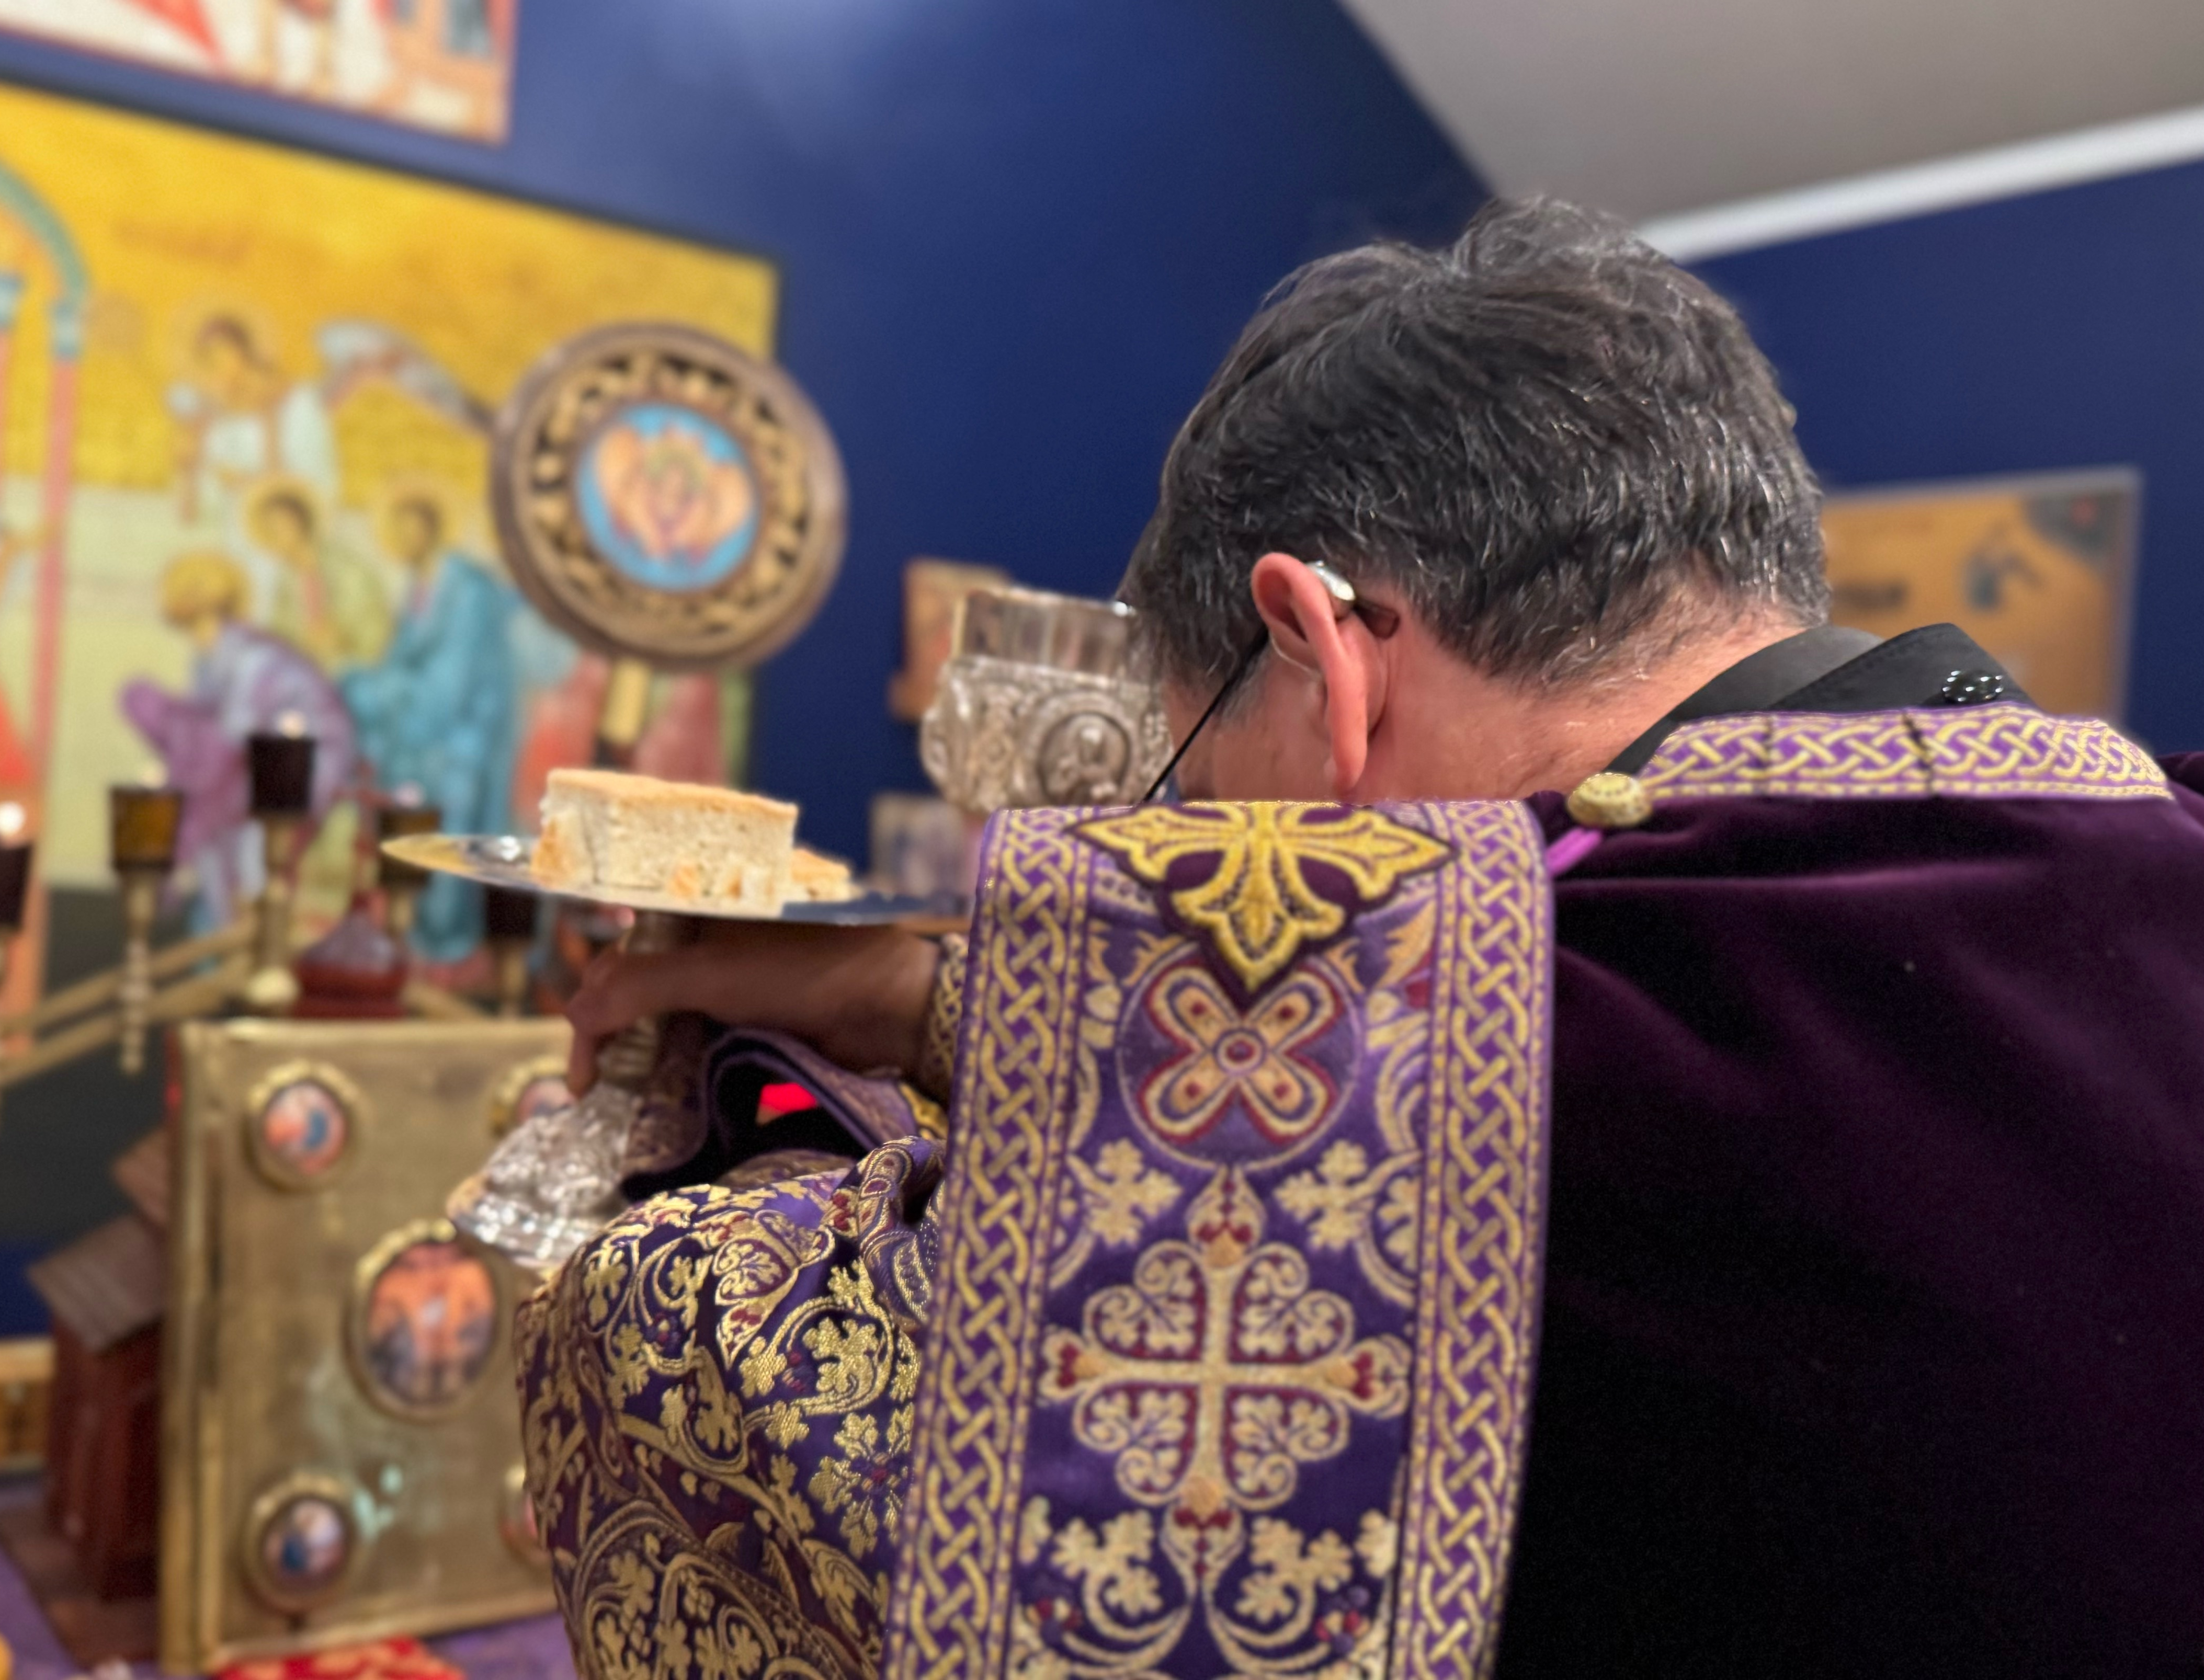
DIVINE LITURGY • CLASS 1
What Do We Offer?
Attention
Thanksgiving
Repentance
Praise
Our bodies and voices
Our whole life
“Thine own of Thine own we offer unto Thee...”
17

Slide 19
DIVINE LITURGY • CLASS 1
Listen Differently This Sunday
“Blessed is the Kingdom...”
“Let us pray to the Lord.”
“Let us commend ourselves and each other and all our life unto Christ our God.”
Notice the language: we are being called to do something.
18

Slide 20
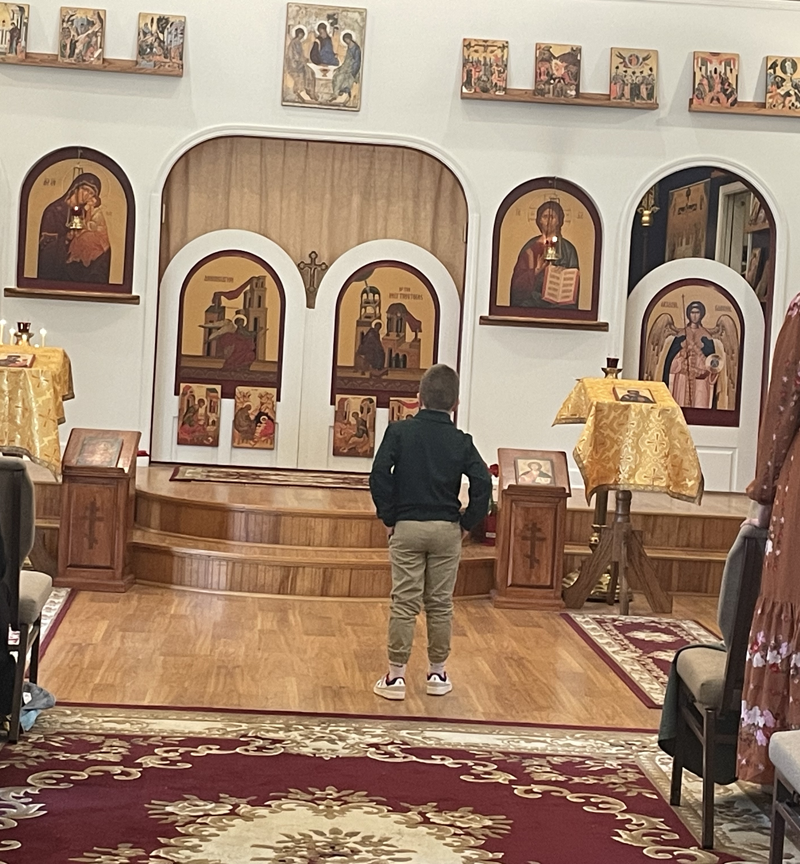
DIVINE LITURGY • CLASS 1
The Big Picture
Created for Communion
↓
Prayer turns us toward God
↓
Worship calls for active presence
↓
The Church worships together
↓
The Liturgy brings us into the Kingdom
19

Slide 21
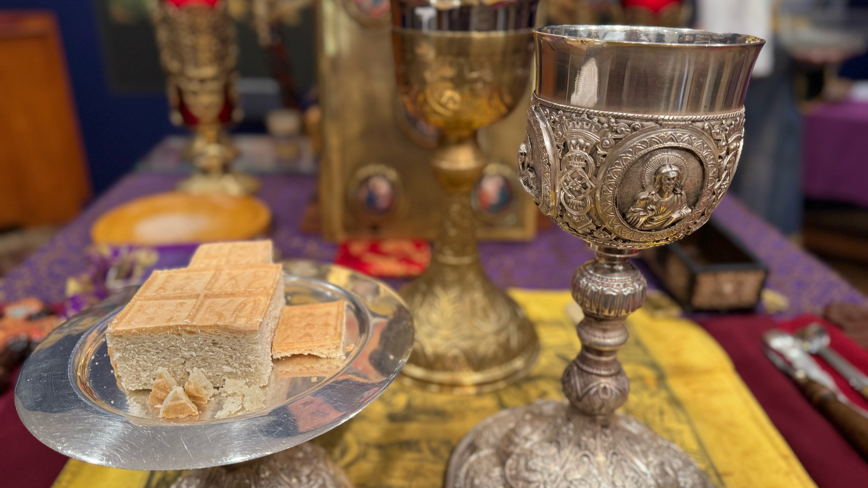
NEXT CLASS: October 2nd, 2026
The Divine Liturgy
20

